Slide 1

A study of VPN Privacy - challenges and opportunities

Slide 2

Overview
Introduction
Literature Review
Research Findings / Result
Discussion
Conclusion

Slide 3
Introduction
VPN privacy involves encrypting your internet connection, masking your IP address, and enhancing online anonymity. It safeguards your data from potential interception, secures public Wi-Fi usage, and enables bypassing geo-restrictions, ensuring a more private and secure online experience.

Slide 4

Research Gap
The research gap lies in insufficiently exploring emerging threats to VPN privacy, neglecting user behaviors and perspectives, overlooking sector-specific challenges, inadequately assessing

Slide 5
Research Objective
It seeks to identify emerging threats, analyze user behaviors, assess sector-specific issues, and quantify the accuracy of privacy claims made by VPN providers.
The impact of VPNs on human rights, explore the integration with emerging technologies, and understand cross-cultural variations in VPN privacy perceptions.

Slide 6
Literature Review
Sr no | Author & Title | Summary
1. | Managing the Cloud: Establishing Standards for Describing Core Tasks of Cloud Creators, Providers - Umang Rastogi | Developed a system categorizing cloud client roles, expanding to 30 detailed roles, anticipating evolving responsibilities amid advancing cloud computing implementation.
2. | IPv6 Leakage and DNS Hijacking in Commercial VPN clients – Vasile C. Perta*, Marco V. Barbera, Gareth Tyson, Hamed | Commercial VPN services often exhibit a serious vulnerability—IPv6 traffic leakage—posing significant risks, especially for users seeking anonymity in oppressive regimes.
3. | An Empirical Analysis of the Commercial VPN Ecosystem – Mohammad Taha Khan , Joe DeBlasio | Prior research on Android VPNs and web proxies indicates potential exploitation. Our findings, while consistent, are limited by scale and focus on paid services, reducing malicious incentives.

Slide 7
Research Design: Hypothesis
H0 : The use of a VPN significantly increases online privacy by encrypting data and masking the user's IP address.
H1 :VPN providers with strict no-logging policies are more effective at protecting user privacy than those that retain user data.

Slide 8
Data Collection
Responses
60 % Responses in favor of VPN Challenges
Analyzed for data Privacy and security vulnerabilities

Slide 9
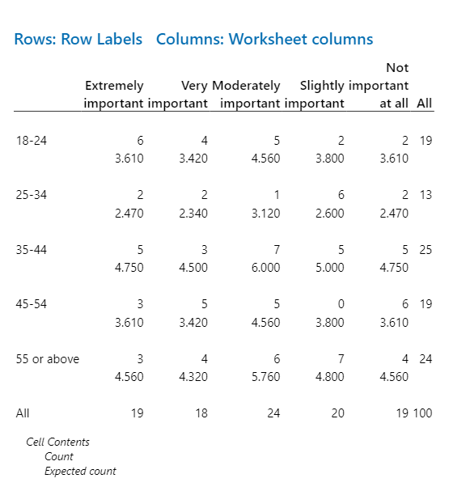
Data Analysis
Data Analysis is performed in Minitab Statistical software
Chi-Square Test
Chi-Square DF P-Value
Pearson 18.004 16 0.324
Likelihood Ratio 20.836 16 0.185
22 cell(s) with expected counts less than 5.0

Slide 10
Data Analysis
Null Hypothesis: The use of a VPN significantly increases online privacy by encrypting data and masking the user's IP address.
Alternative Hypothesis: VPN providers with strict no-logging policies are more effective at protecting user privacy than those that retain user data.
Chi-Square = 18.004 with
16 degrees of freedom
P-Value: 0.324
The p-value for the Pearson chi-square test is 0.324, which is greater than 0.05. This means that we cannot reject the null hypothesis that there is no association between the two variables. The p-value for the likelihood ratio chi-square test is 0.185, which is also greater than 0.05. However, there are 22 cells with expected counts less than 5. This means that the chi-square test may not be reliable.

Slide 11
Research Findings/Result
The results of the chi-square test suggest that the use of a VPN does not have a significant impact on online privacy. This could be due to several factors, such as the fact that many VPNs do not offer high levels of encryption, or that users may not be using their VPNs correctly.
The study also found that people are interested in using VPNs for other reasons, such as accessing geo-restricted content, bypassing censorship, and protecting sensitive data on public Wi-Fi.

Slide 12

Limitations
It is important to note that the chi-square test is only a statistical test, and it does not prove that the use of a VPN does not increase online privacy. It is possible that the test was underpowered, or that there were other factors that influenced the results.
You should also be aware that no single measure can guarantee your online privacy. It is important to take a layered approach to security by using a combination of different methods.

Slide 13
Conclusion
The primary goal research was to judge the effective of VPN services currently offered by various service providers and ascertain their ability to provide security and privacy to consumers. The study also investigated the existing issues and potential security vulnerabilities in consumer VPN services using various approaches.
The key finding of this research is that consumer VPN service providers need to enhance user confidence through improved communication and transparency with end-users. Furthermore, the establishment of a monitoring body is necessary to ensure the safety of the consumer VPN system for end users. These companies prioritize providing their customers with attractive features at reasonable prices. Additionally, they may consider offering additional security features such as intrusion prevention, virus protection, and data transit security.

Slide 14
THANK YOU

